Slide 1
“aki” the drummer”
BASS! TONE! SLAP!

Slide 2
MEET THE MAN!

Slide 3
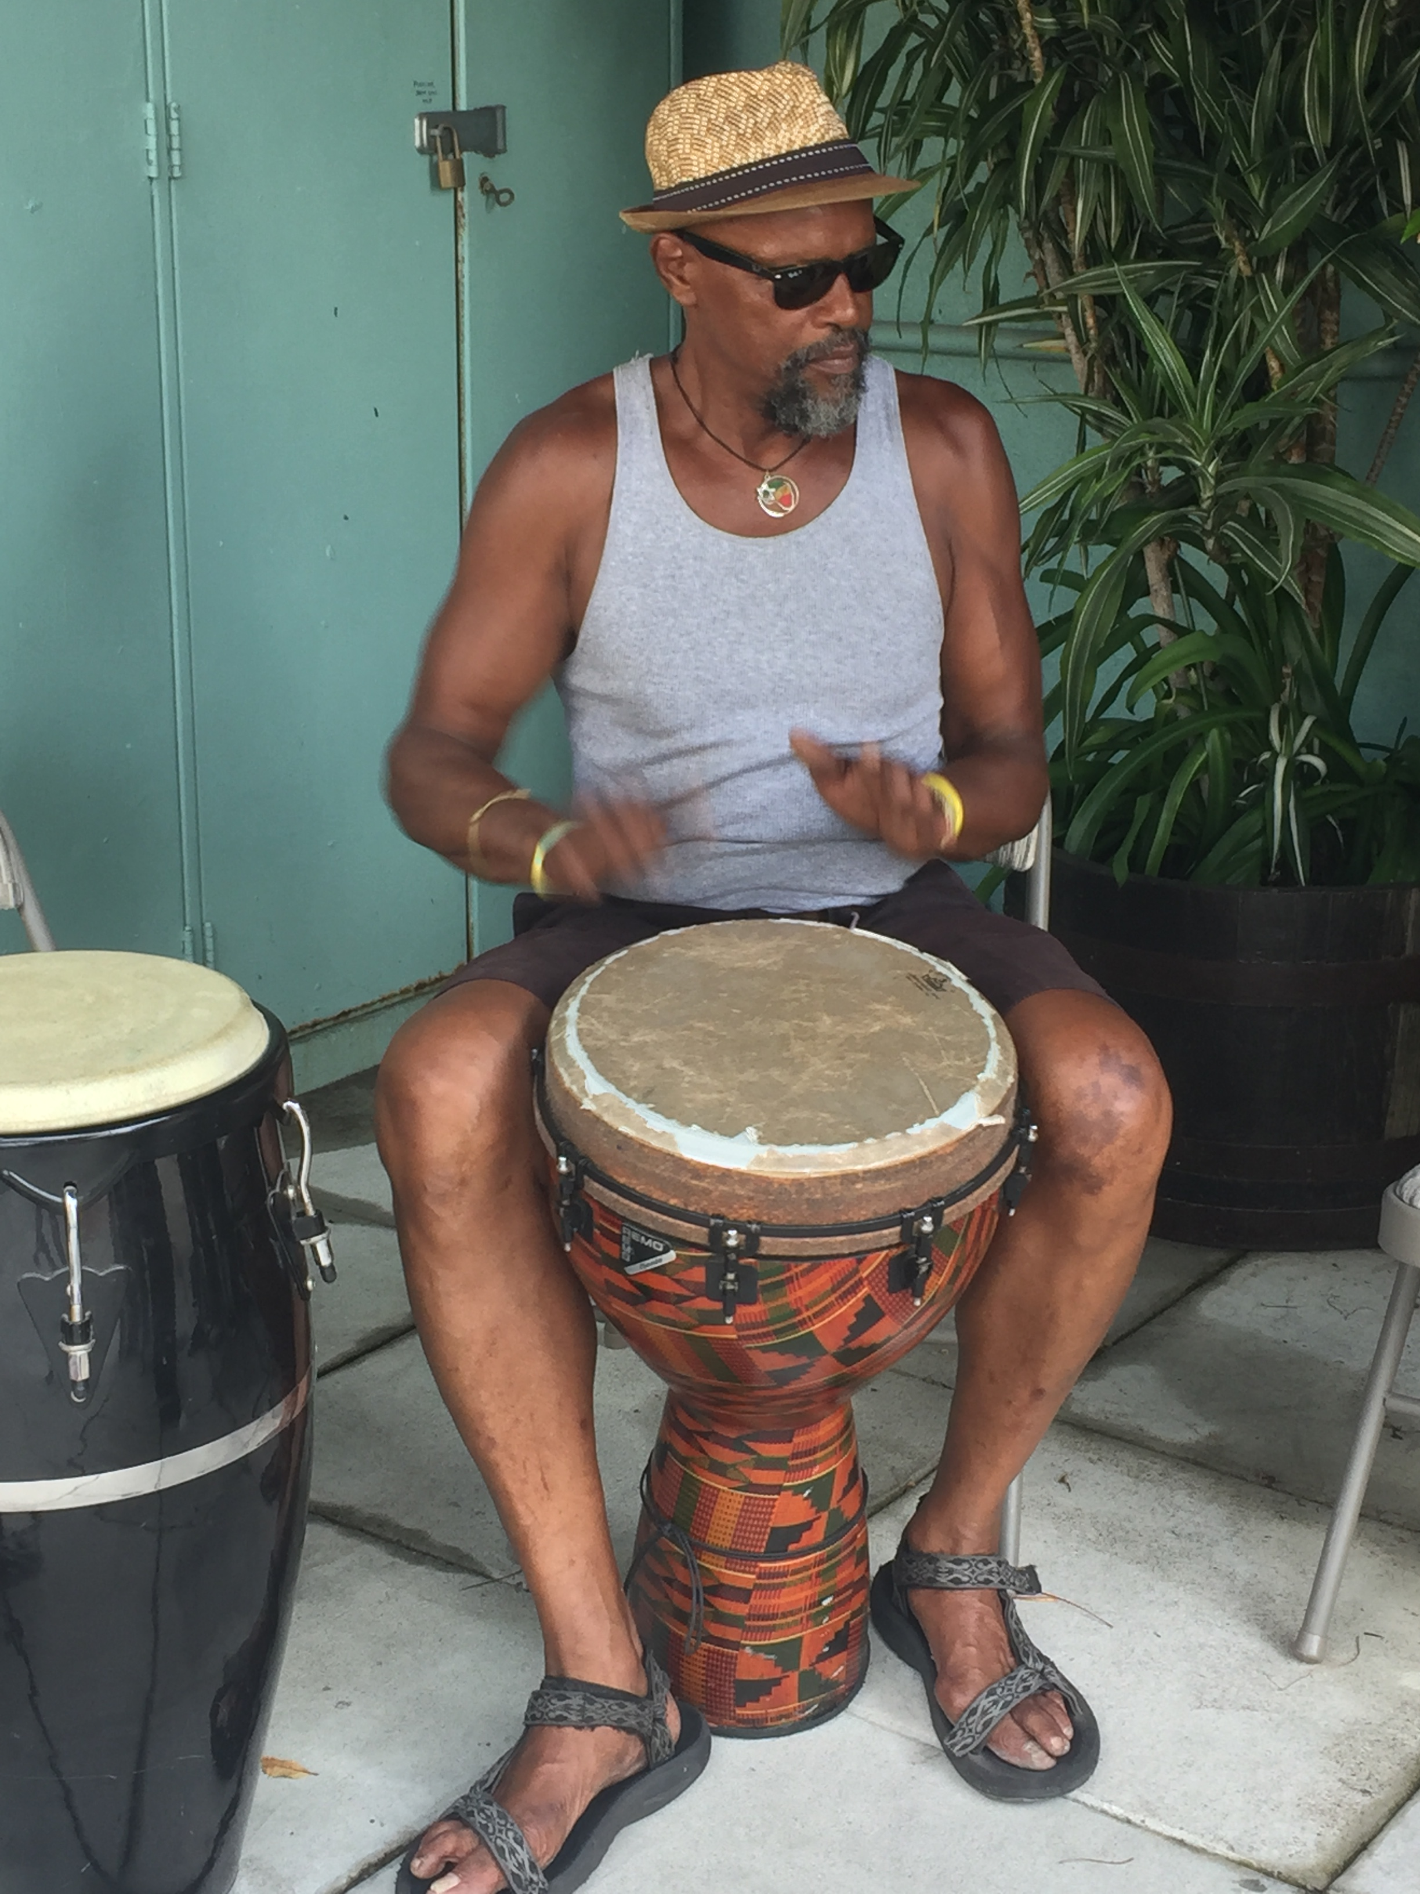
DRUM CIRCLES
LET AKI KNOW WHEN AND WHERE YOU WOULD LIKE TO ORGANIZE A DRUM CIRCLE FOR AN EVENT.
DRUM CIRCLES CAN BE A ONE TIME SPECIAL EVENT OR
A SERIES OF SCHEDULED DRUM CIRCLES
DRUM CIRCLES AT MURAMID ARTS AND CULTURAL CENTER IN OCEANSIDE
DRUM CIRCLES AT YOUR LOCATION
SMALL FEE AND DONATION BASED WITH OTHER FREE BASED SELECTED SCHOLARSHIPS

Slide 4
AKI DRUMS WITH “SPECIAL ABILITIES” CLIENTS WHO LOVE DRUMMING

Slide 5
Oceanside’s “best OF THE BEST “SPECIAL PEOPLE” drum with Aki….
Meet Greg Snaer….an incredible musician and advocate of the arts and for all humanity…He’s known for his wisdom and everything from YOGA instruction to counseling ability, Greg is also an ordained minister, an Executive Development Officer and a good friend who really knows how to keep a secret! Those of us who know Greg, really feel honored and privileged and his presence in the new Muramid Arts and Culture Center is very dear to us!

Slide 6
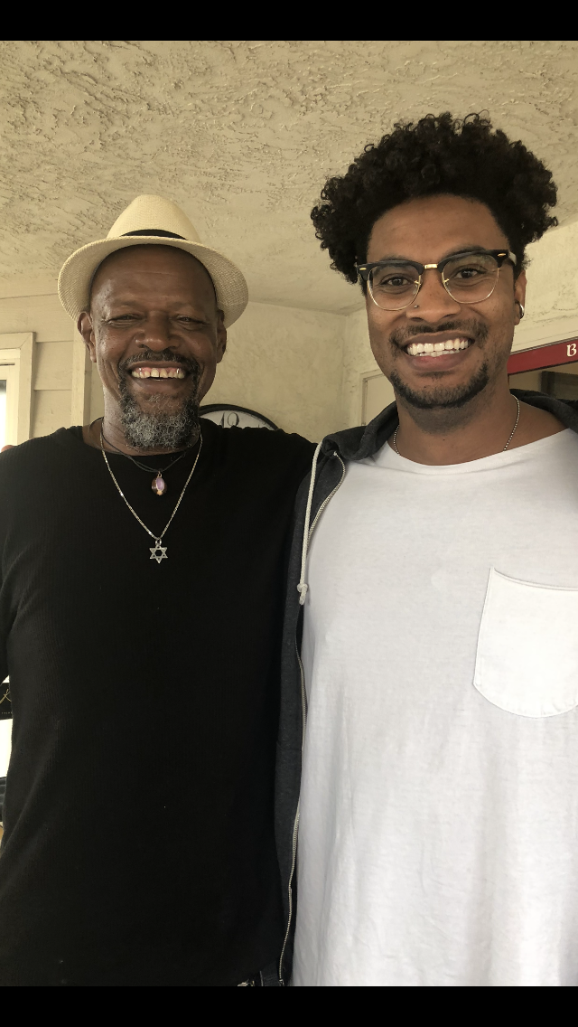
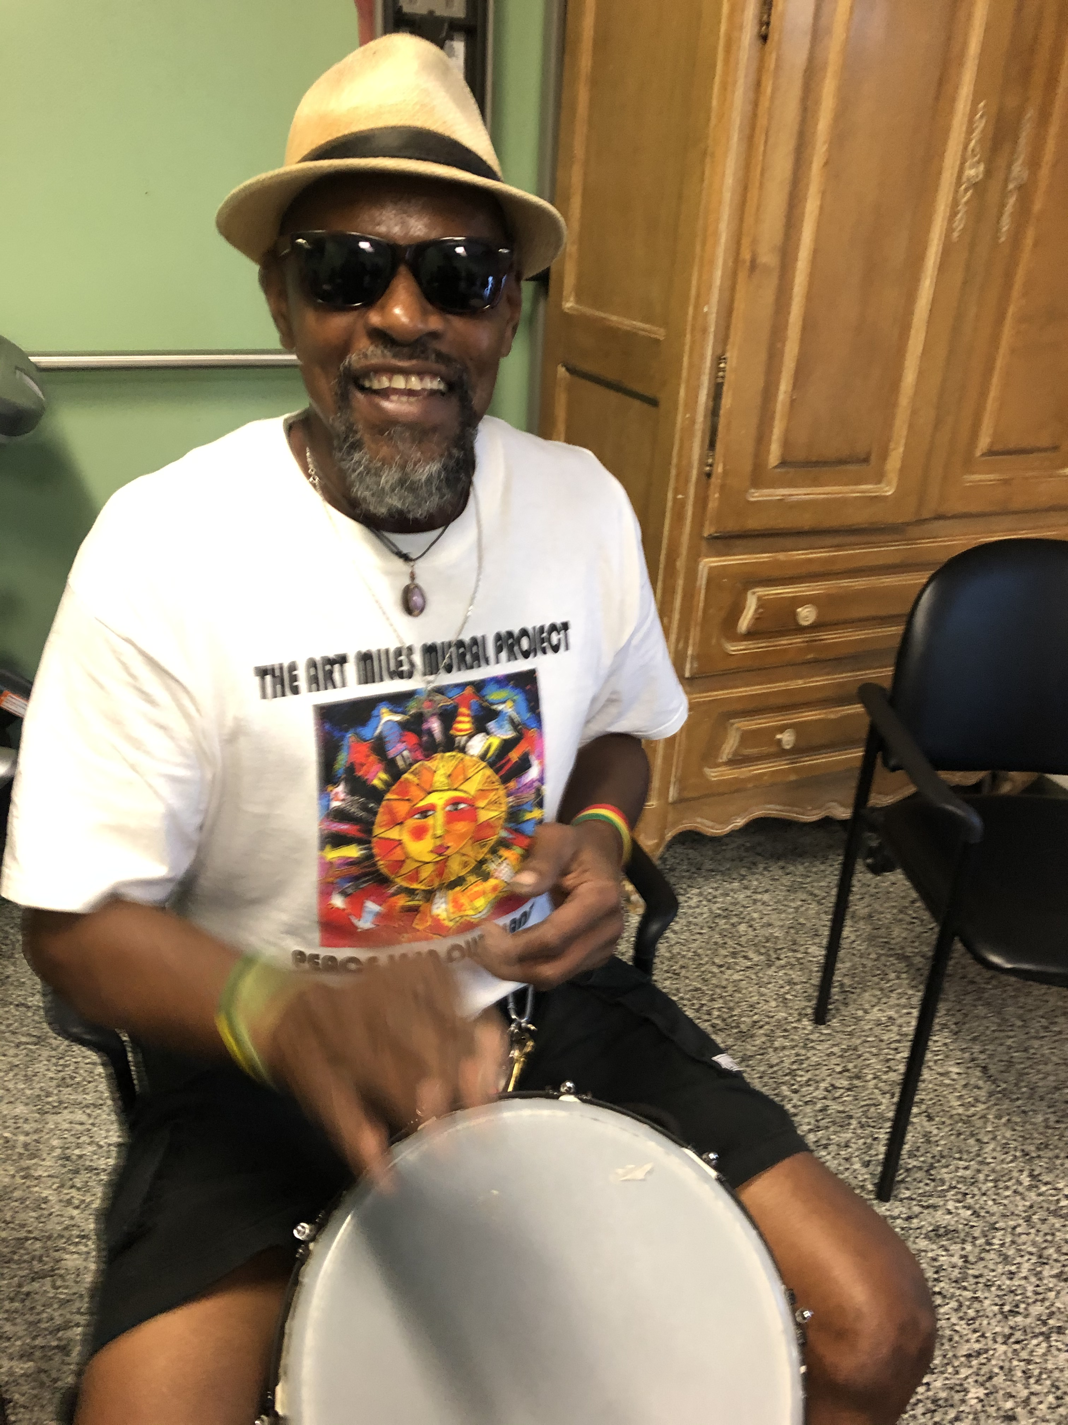
AKI DRUMS FAITFULLYFOR THE ART MILES MURAL PROJECT AND FOLLOWS THE WORK OF
SO MANY RISING STARS
LIKE CHRIS BROWN
WHO EPITOMIZES THE “TRUE GOOD, TRUE GRIT, TRUE PASSION” FOR HIS ART AND FOR ALL HUMANITY…LIKE HAVING A LITTLE BROTHER WE CAN ALL JUST LOVE A LOT!

Slide 7
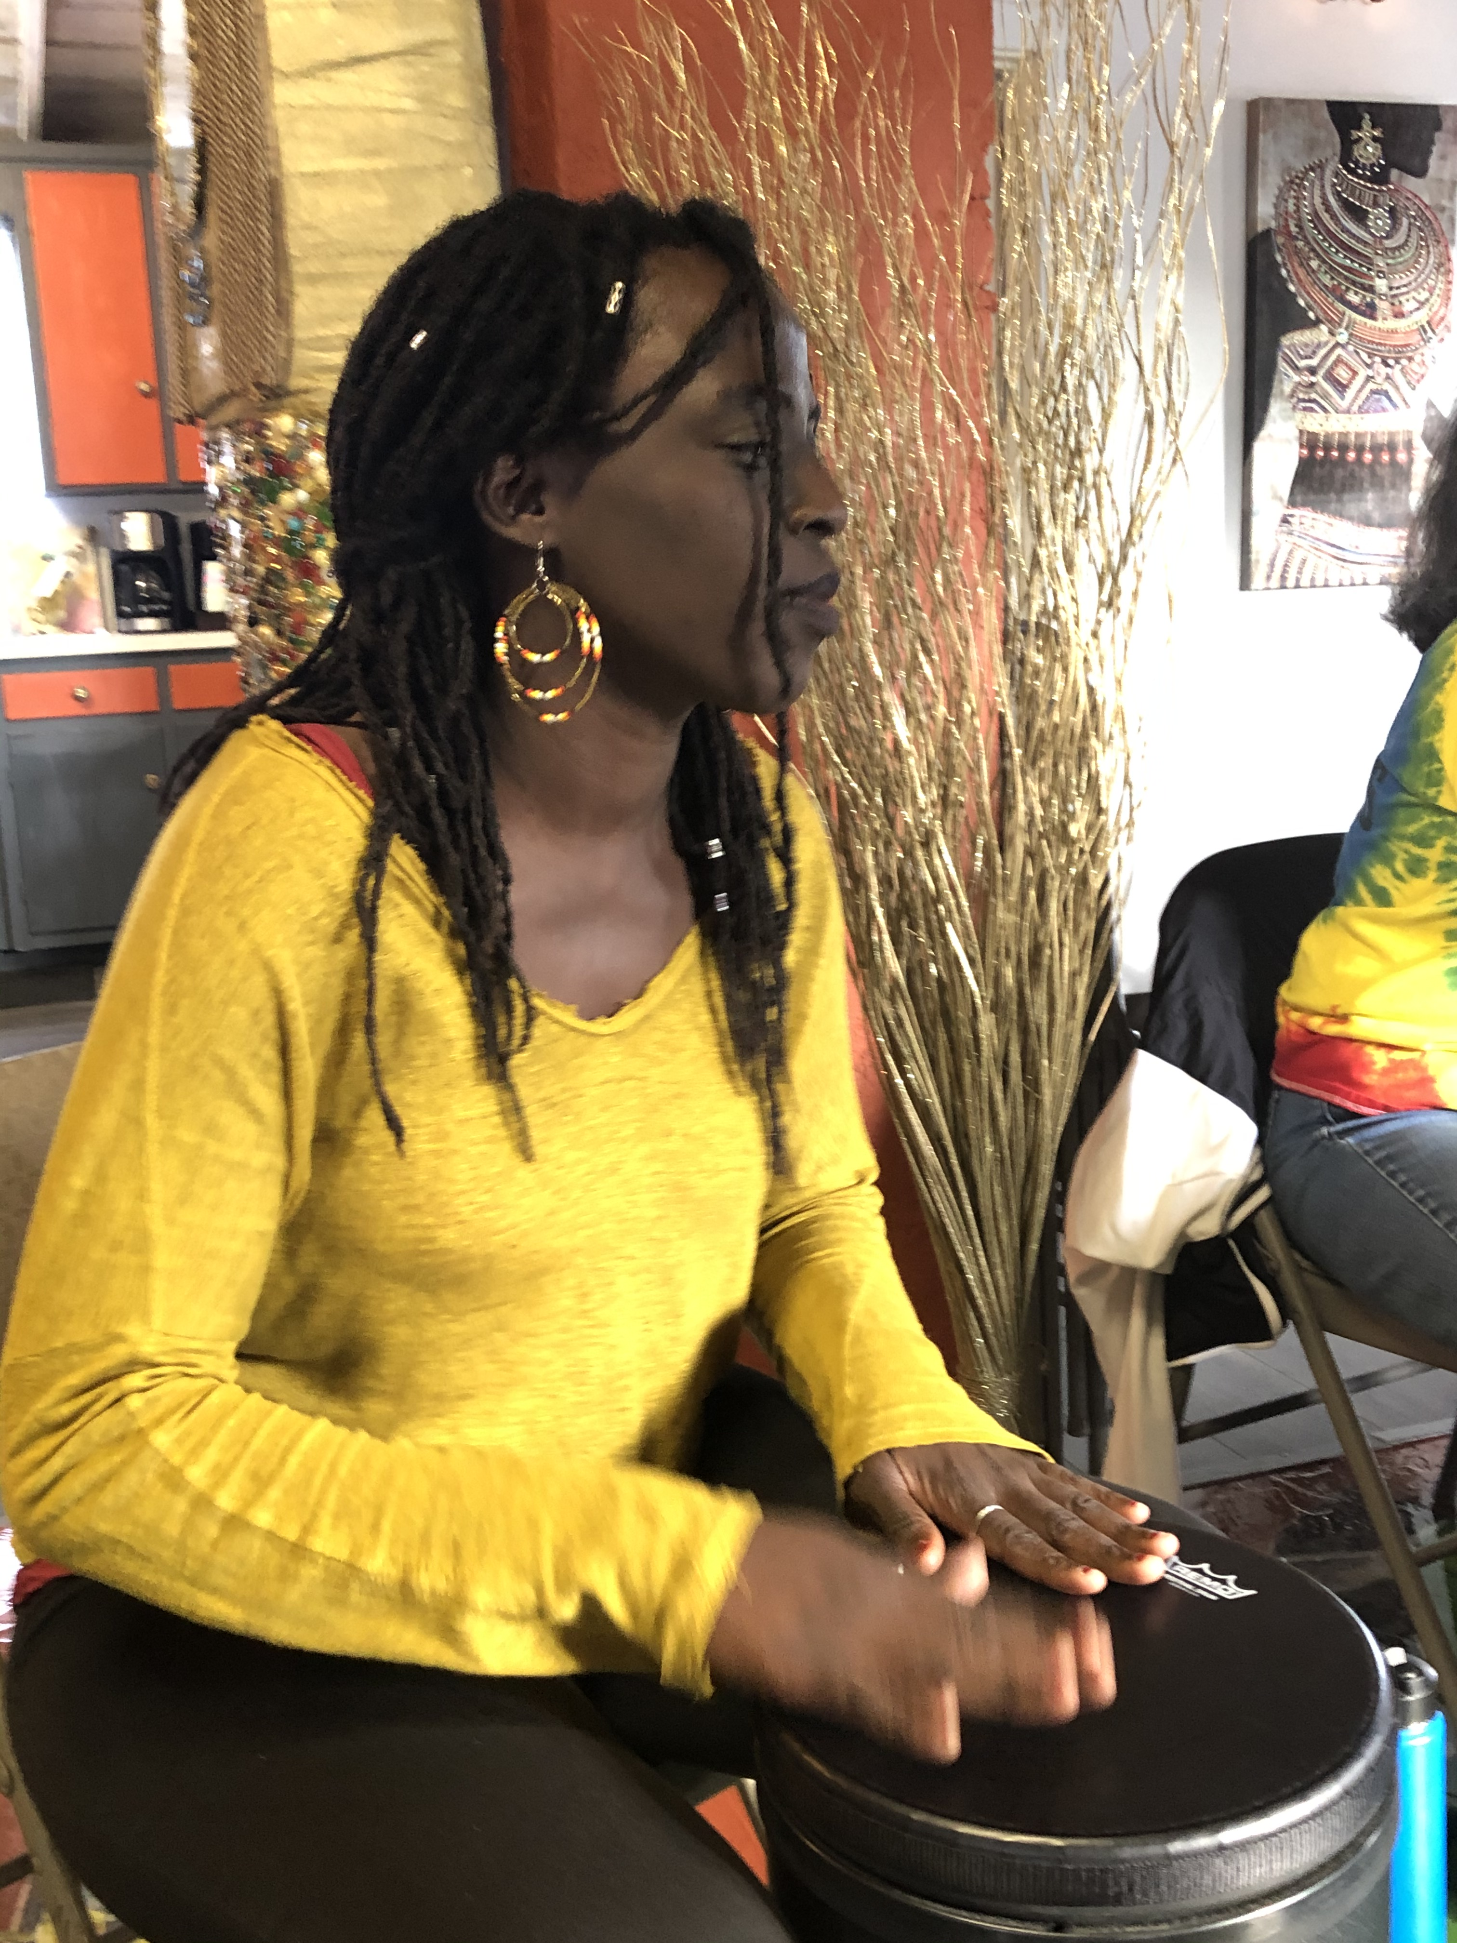
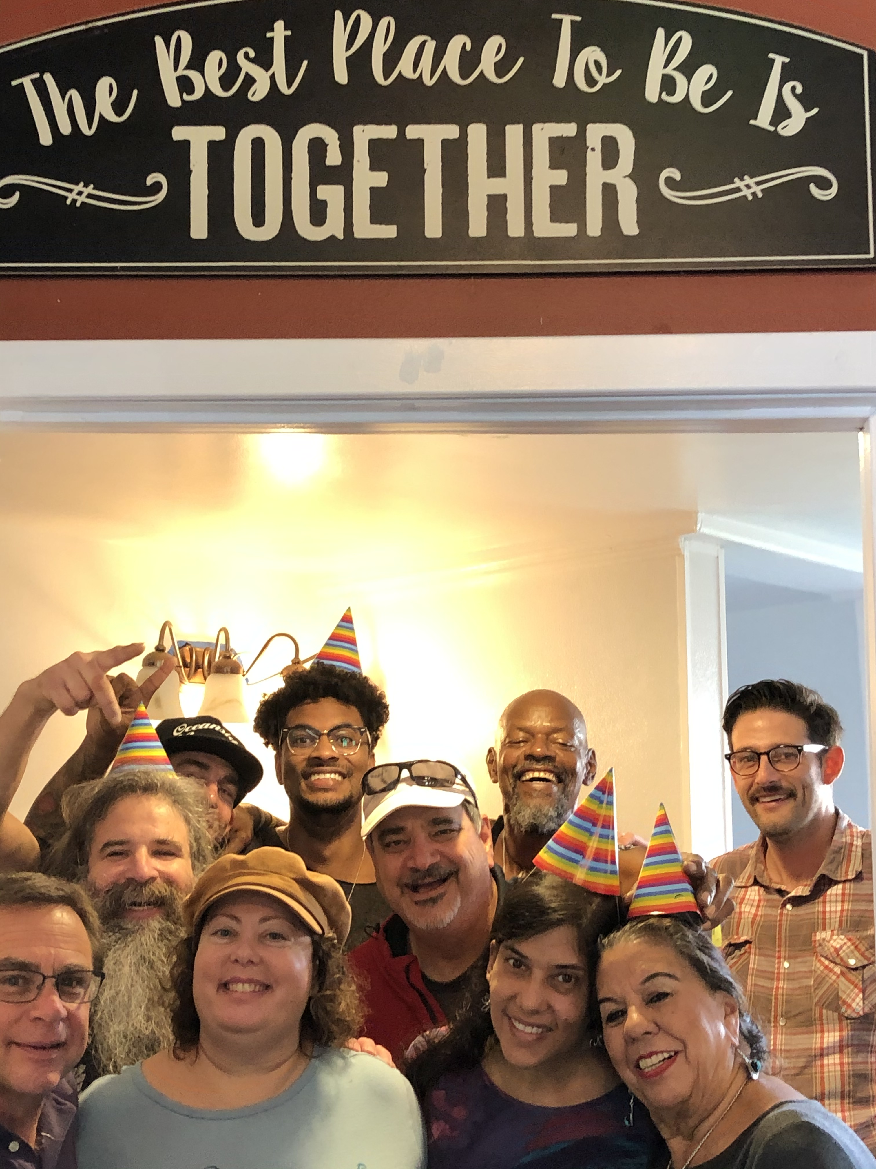
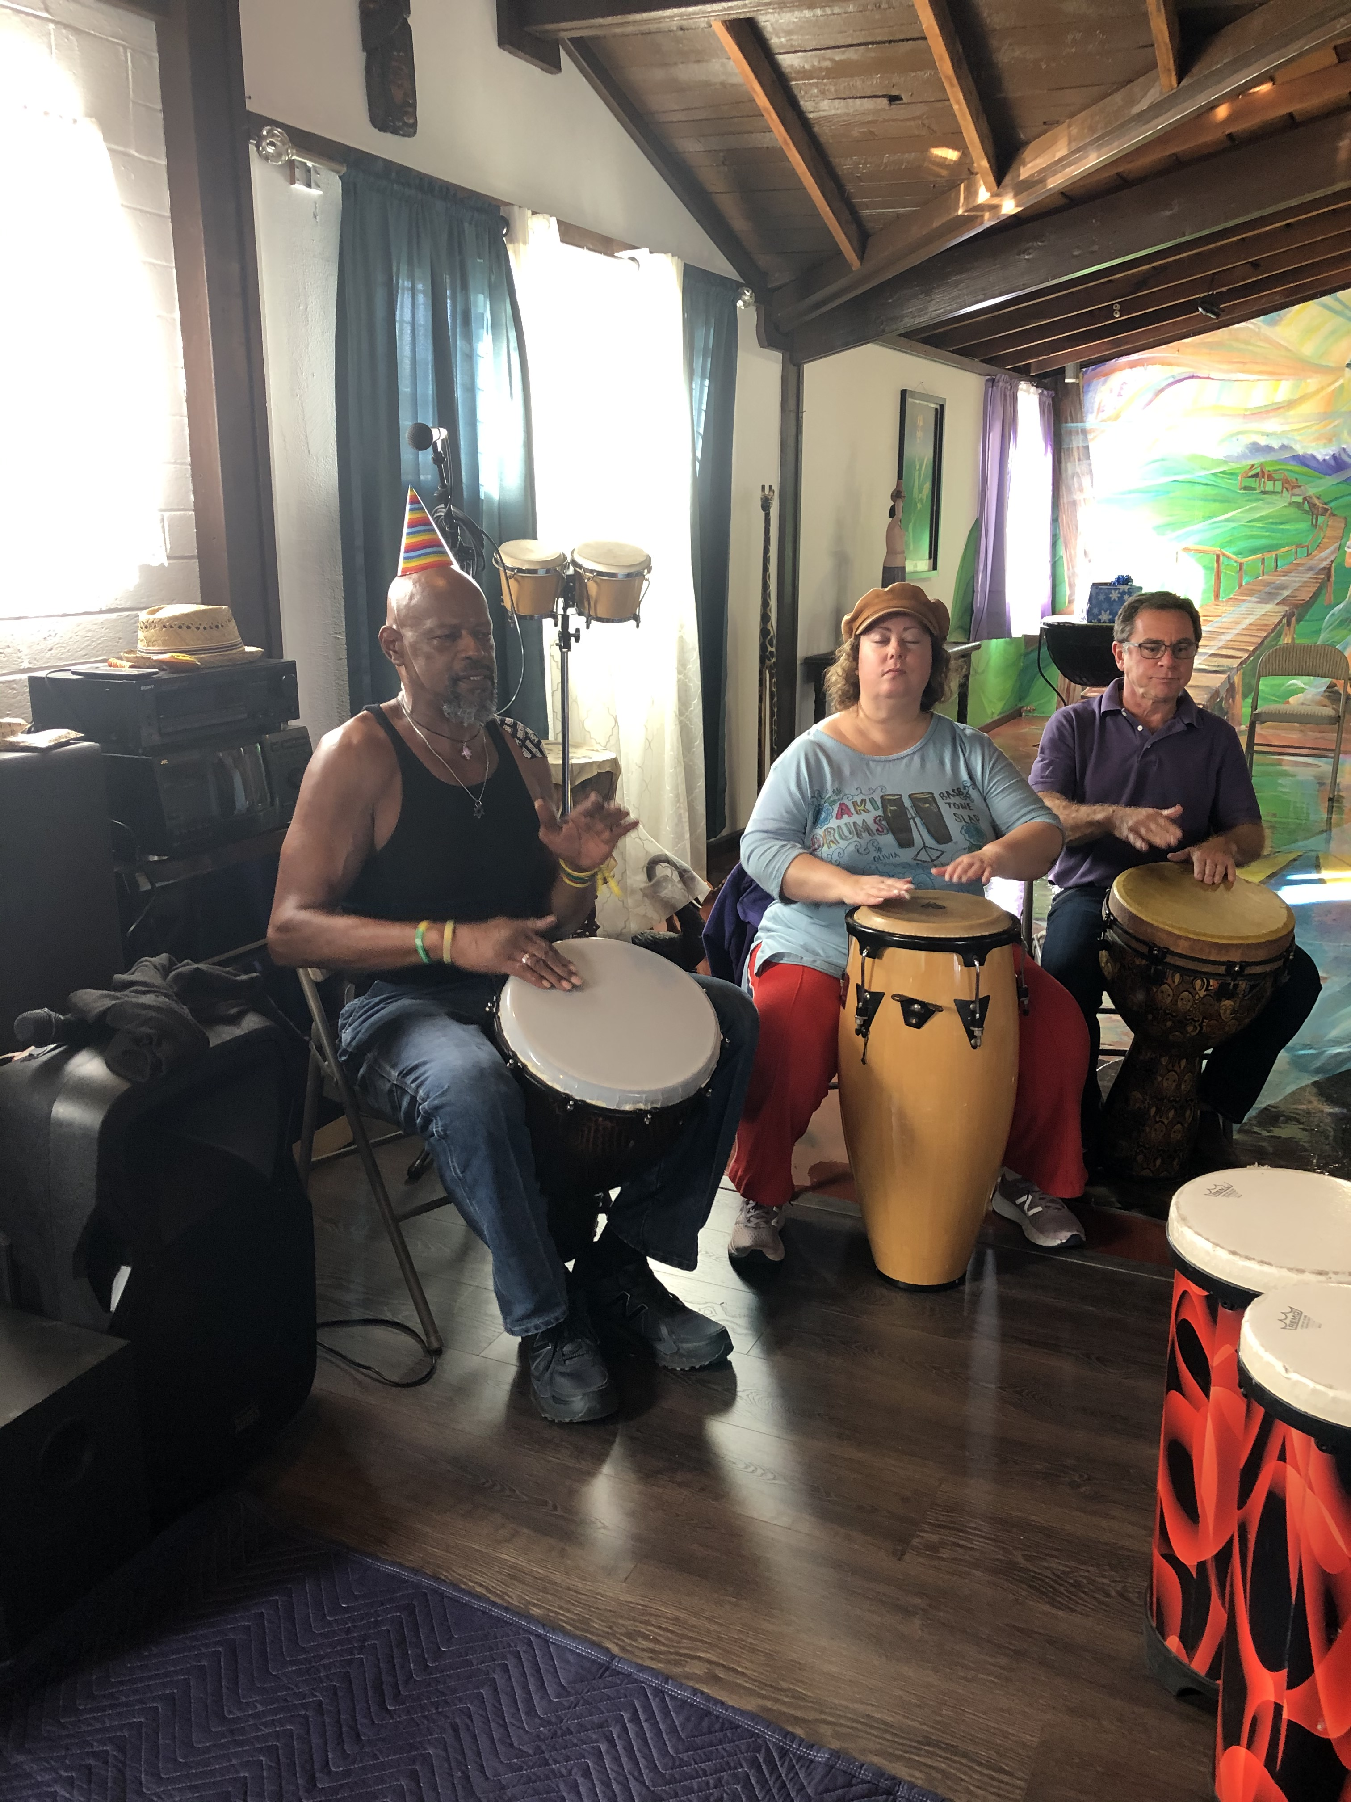
Aki’s regular drumming circle gather for his birthday!

Slide 8
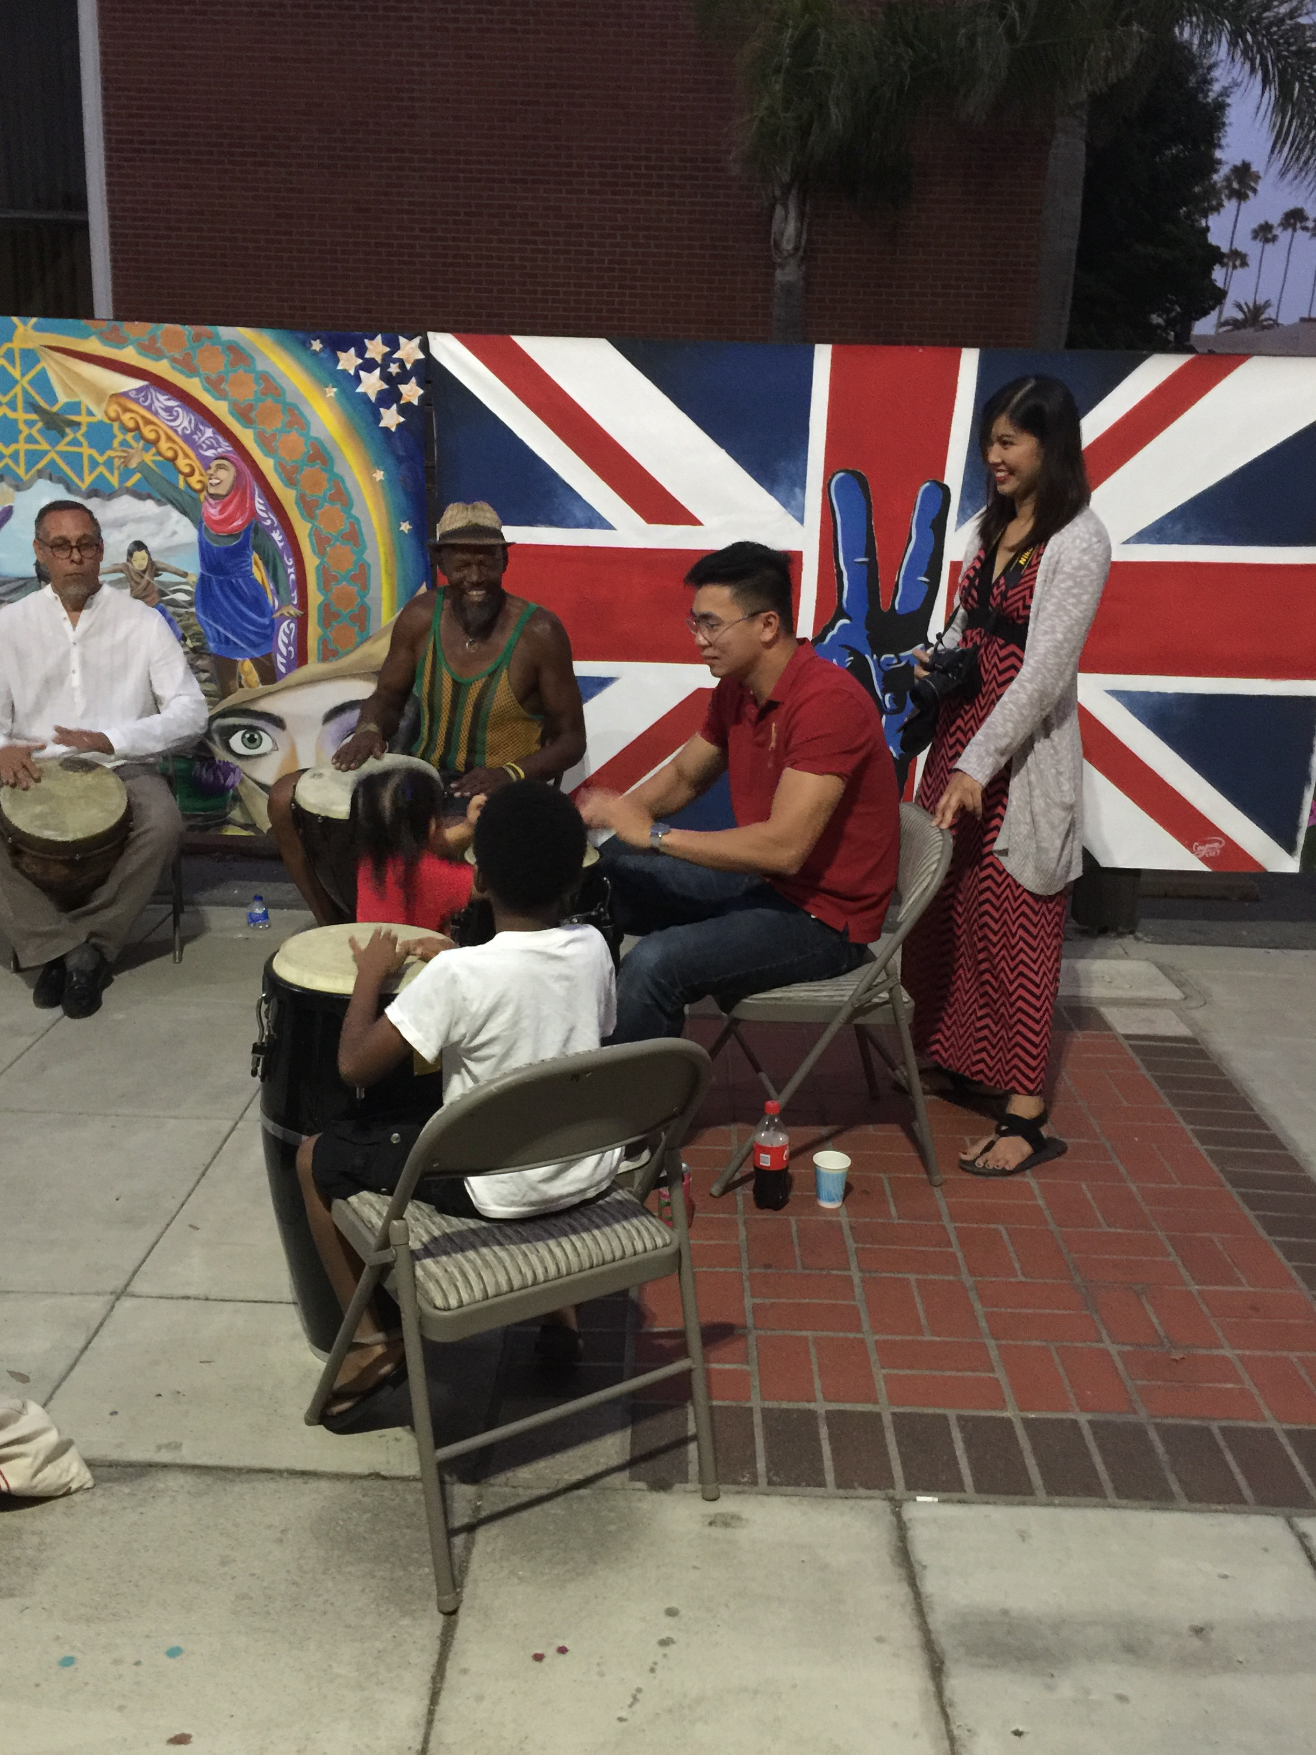
Drumming in artist alley with aki…
All ages and families are included and having real
FUN!

Slide 9
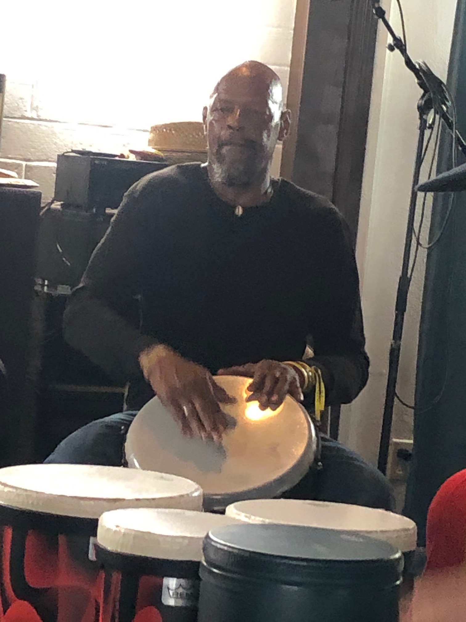
AKI DRUMS FROM HIS HEART AND YOU WILL ALWAYS LEARN THAT HIS BASIC DRUMMING LESSON STARTS OUT WITH “BASS” “TONE” “SLAP”

Slide 10
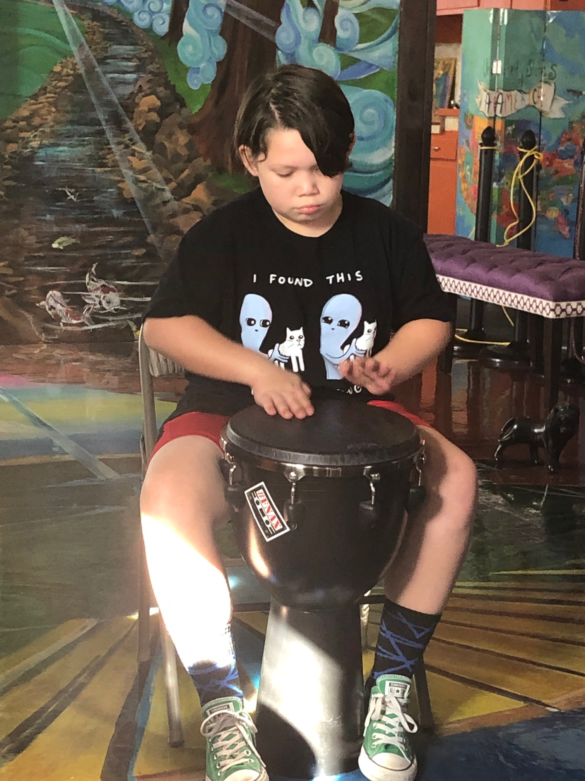
WORKING WITH a YOUTH “PRODIGy” IS A TRUE PLEASURE WITH AKI BECAUSE HE KNOWS AND UNDERSTANDS REAL TALENT AND LOOKS FOR YOUTH TO JOIN HIM AND SHARE THE PASSION THAT COMES WITH THIS ART AND TO INSPIRE YOUTH TO AIM FOR THE STARS!

Slide 11
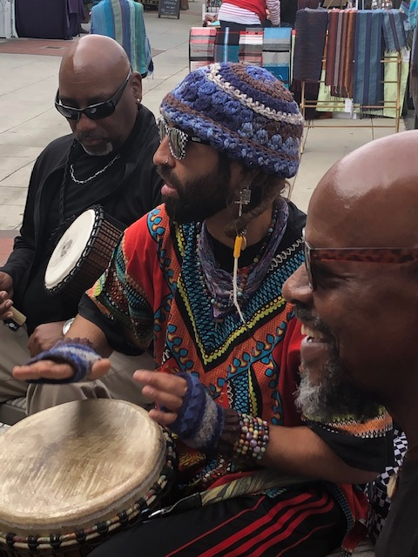
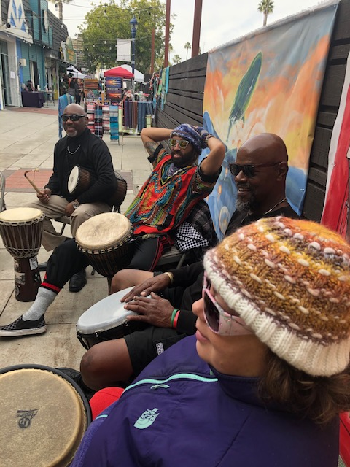
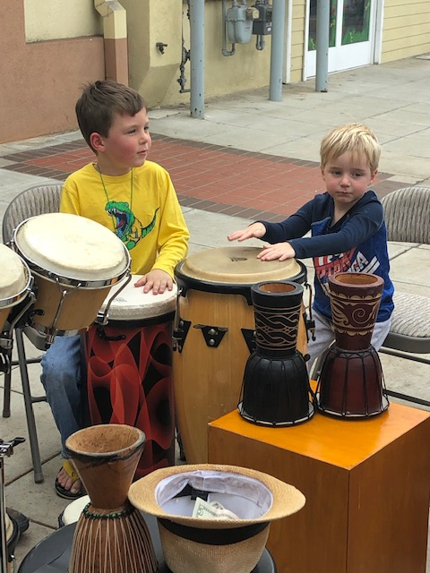
DRUMMING IS IMPORTANT TO ALL AGES AND AKI MAKES IT EVEN MORE FUN!
FUN!
FUN!
MORE FUN!

Slide 12
Lessons…special events performances…parties…
AKI IS AVAILABLE TO BOOK ACTIVITIES FOR ALL AGES FROM YOUTH TO SENIOR CITIZENS, TO SPECIAL NEEDS AND DISABLED VETS…DRUMMING HEALS NOT ONLY FOR CLIENTS BUT FOR ALL THE DRUMMERS WHOSE PASSION AND EMOTIONS ARE TRANSLATED INTO DRUMMING AND RHYTHMIC TOGETHERNESS…AKI LIKES IT WHEN EVERYONE BEATS THE DRUM THEIR OWN SPECIAL WAY AND FOLLOWS THE LEAD…MAKING BEAUTIFUL MUSIC FOR EVERYONE TO ENJOY! SO JOIN AKI…SIGN UP AND/OR COME BY THE MURAMID ARTS AND CULTURAL CENTER AND SEE HOW IT ALL COMES TOGETHER ON SATURDAYS FROM 1-3 PM!
PUBLIC ALWAYS WELCOME

Slide 13
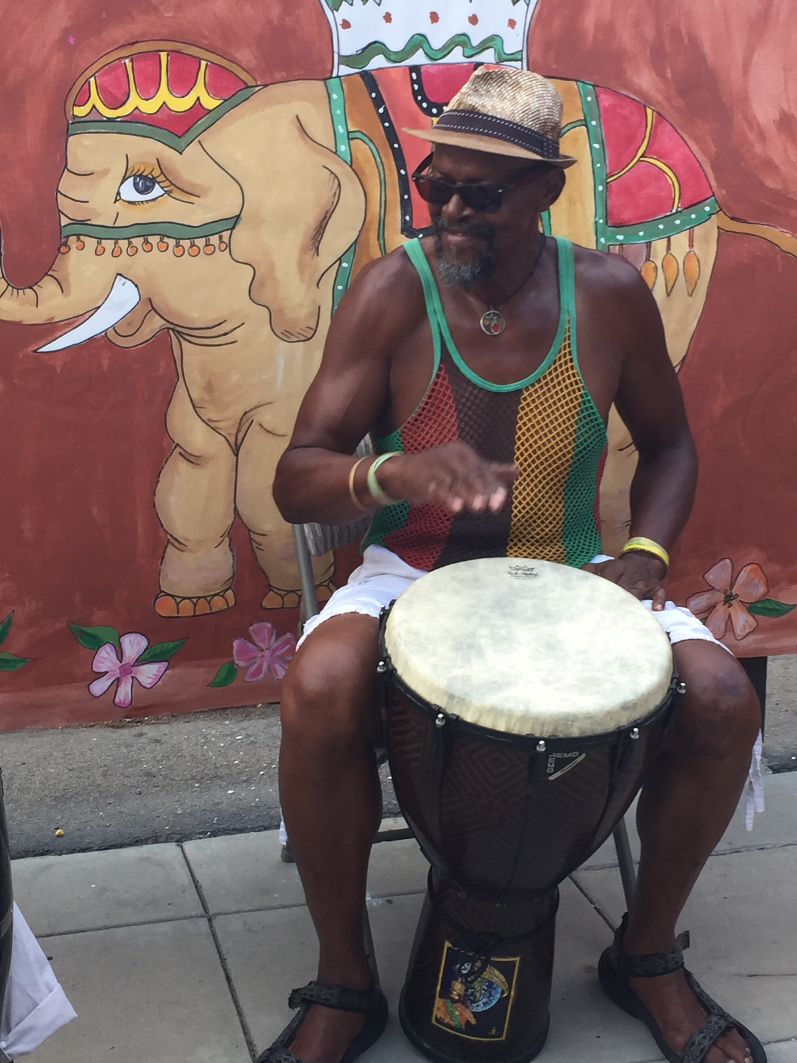
AKI CAN DO MANY THINGS FOR YOU!
BESIDES DRUMMING CIRCLES AND LESSONS….
HE CAN REPAIR YOUR DRUM
HE CAN HELP YOU BUY OR SELL YOU A DRUM…OR
SELL YOUR DRUM…OR TRADE YOUR DRUM…OR

Slide 14
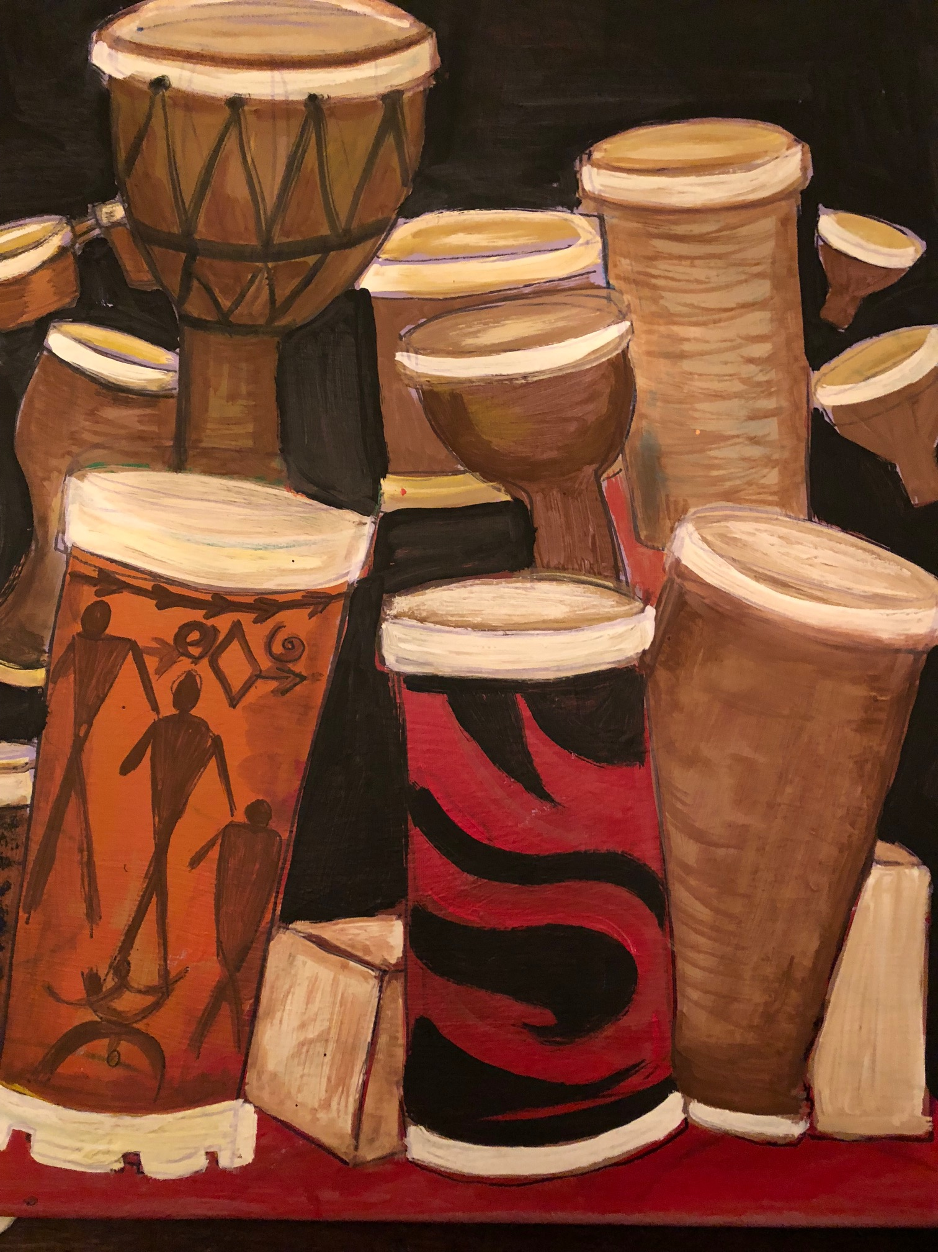
MANY THANKS TO ALL WHO DRUM…and the beat goes on AND THE BEAT GOES ON!
By Joanne Tawfilis, PhD Fine Arts
EXECUTIVE DIRECTOR
MURAMID ARTS AND CULTURAL CENTER
480 NORTH EL CAMINO REAL
OCEANSIDE, CALIFORNIA 92058
WWW.MURAMID.COM

